Slide 1


Final Year Project Presentation on Low Cost Automated Guided Vehicle
By
1CR17EC005 ABHIMANYU RAJU 1CR17EC019 AMLAN DASH 1CR17EC161 S SHASHANK REDDY
Under the Guidance of Prof. Rahul Tiwari
Department of Electronics and Communication Engineering
18-06-21

Slide 2
OUTLINE
This final year project was carried out at Rajamane Industries Pvt. Ltd. The objective of this project was to develop a low cost AGV that could be deployed at the various manufacturing units of the organization.
The project was also launching a startup “Indura”, as an organization that manufactures low cost industrial AGV’s providing a low-cost alternative to small/medium-scale industries to improve their efficiency.
The team took part the Ministry of Education’s Innovation Cell’s ‘National Innovation Contest’ and is a part of the 127 teams out of 9000, selected for the final round!

Slide 3
INTRODUCTION
This project explores the domain of mechatronics and create a tool which finds actual usage in real life. Having taken inspiration from Make it India initiative, we diverted our thoughts into visualizing and designing a tool that can be completely conceptualized, designed, manufactured and put to use in various sectors thereby solving a real world problem.
The problem we identified was that of movement of goods/cargo in small-medium scale industries. We discovered that lots of passive human resources were being utilized to take care of these tasks, which were extremely repetitive in nature and was something which could be automated.
We decided to use technology to tackle the difficulty which led us to conceptualizing an Automated tool.

Slide 4
INTRODUCTION
Automated Guided Vehicles (AGV) are computer-controlled and wheel-based load carriers that travel along the floor of a facility without an onboard operator or driver.
Their movement is controlled by a combination of software and sensor-based guidance systems. They move on a predictable path with precisely controlled acceleration and deceleration, AGVs provide safe movement of loads.
Typical AGV applications include transportation of raw materials, work-in-process, and finished goods in support of manufacturing production lines.
They are also used for storage/retrieval or other movements in support of picking in warehousing and distribution applications.

Slide 5
INTRODUCTION
Increasing popularity of AGVs is due to the increased efficiency and reduced costs that can be gained in manufacturing and distribution facilities.
These futuristic vehicles run on the plant floor and help move products from point A to point B without the need for an onboard operator or driver. This makes AGVs a cost-effective machine, for a variety of industries, including automotive, food and beverage, chemicals and plastics, commercial print, paper and pharmaceuticals.
The AGVs capability to efficiently and accurately move the raw material to the required destination, reduces human dependance on tasks, hence allowing companies to direct employee time on activities that have higher value.
The organizations benefit by lowering the labor-cost , product damages, improved safety, increased efficiency and guaranteed on time delivery.

Slide 6

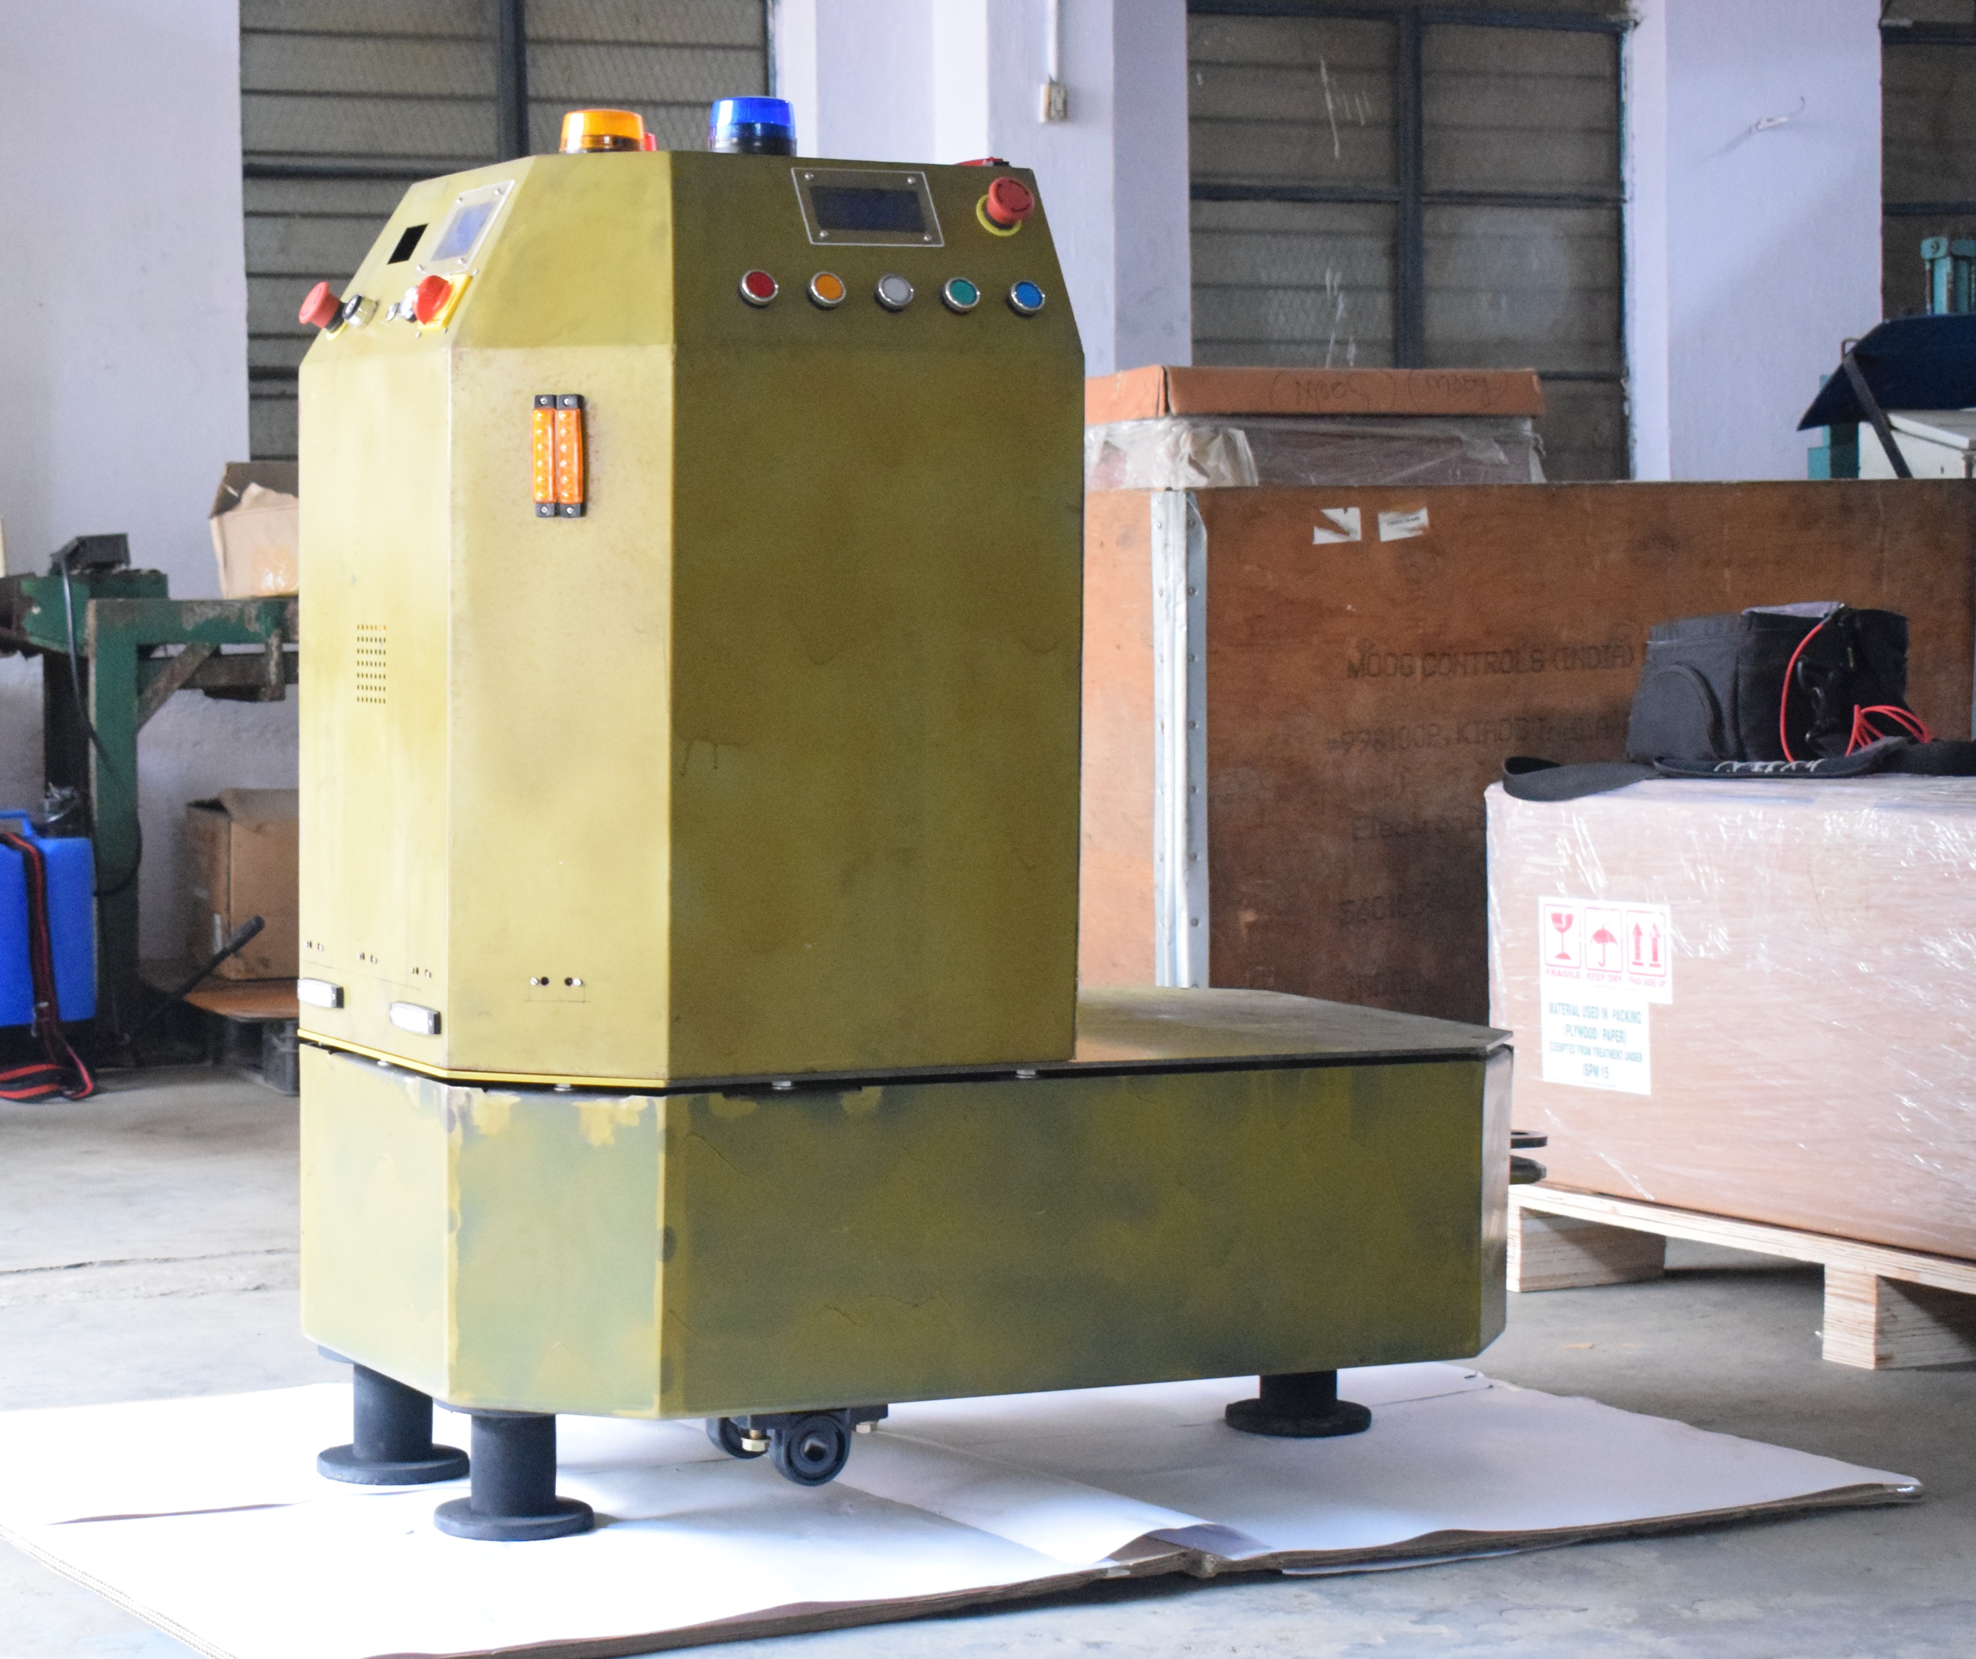
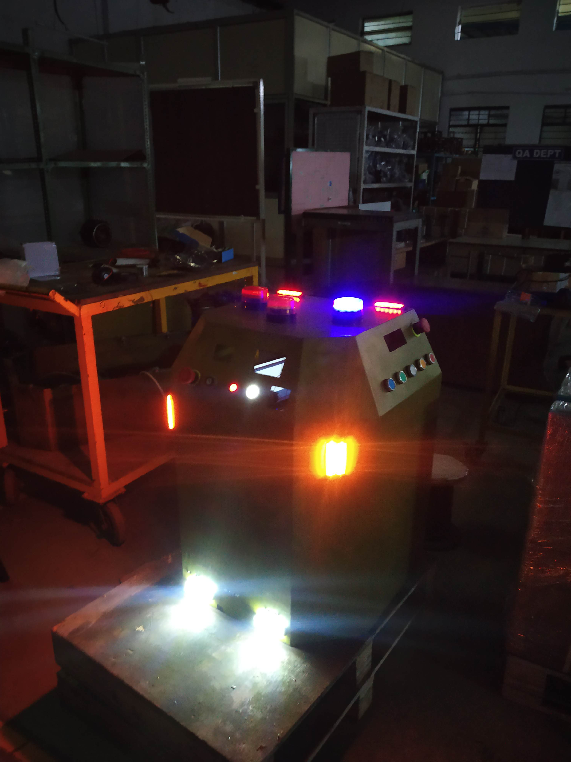
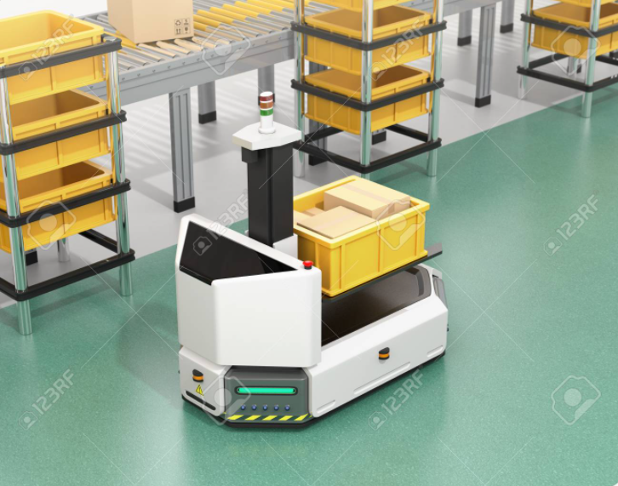

Slide 7
OBJECTIVE
The objective of this project is to design and develop a low-cost AGV with a load capacity of 2000 Kgs, fully functional with various on-board time critical guidance systems and sensory equipment that enable it to autonomously function in a real-life factory environment.

Slide 8
Guidance Path System
The guidance path system is used to decide and program the path that needs to be followed, as well as instructs the AGV on how to follow the path.
The AGV utilizes values from its various sensory systems and compares it with the values provided by the vehicle guidance system to compute the amount of acceleration/deceleration or direction change required.
On encountering a decision point along the path, the AGV decides whether to follow the path.
The commonly used guidance path systems are:
Landmark based navigation.
Behavior based navigation.
Vision based navigation.
Department Of Electronics And Communication

Slide 9
Landmark Based Navigation
The Landmark based navigation technique is based on identification and subsequent recognition of distinct features of an object in the environment that maybe priorly known or extracted dynamically.
The different technologies used are embedded guide wire and taped type system(line follower).
In the embedded guide wire system, electrical wires are placed in small channels inside the floor of the workspace. The AGV senses the low current with frequency in the range 1-15kHz. Varying frequencies are used to control the AGV to make the required changes to direction and speed.
In the guided tape or line follower system, the AGV detects and follows a pre-defined line drawn on the work-floor. To detect the line, the AGV utilizes an array of sensors which sends control signals to the AGV, which uses correction signals to keep the AGV on the required path.
Department Of Electronics And Communication

Slide 10
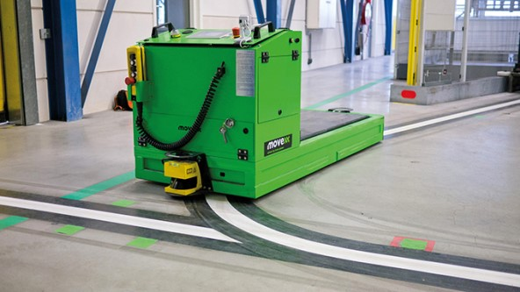
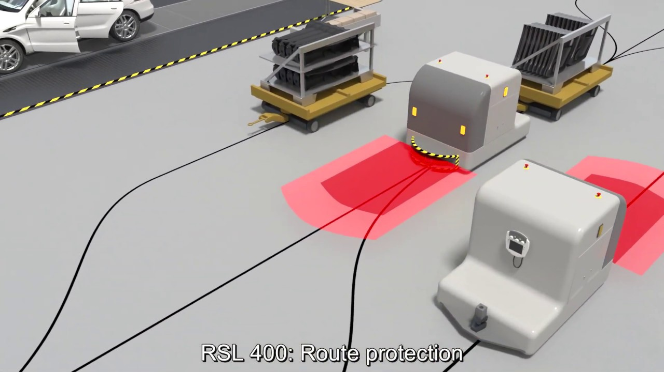
Landmark Based Navigation

Slide 11
Behavior Based Navigation
In unknown environments, the behavior-based architecture is often used.
It splits a complex navigation task into sub-tasks or behaviors.
Each behavior is implemented by a fuzzy controller and is executed independently to deal with a specific problem of navigation.
The controller is modified to contain only the fuzzification and interference procedures, so that its output is a membership function representing the behavior’s objective.
Department Of Electronics And Communication

Slide 12
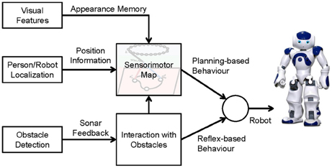
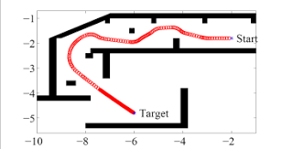
Behavior Based Navigation

Slide 13
Vision Based Navigation
The vision-based guidance system can operate even without a continuously defined pathway.
It utilizes computer vision algorithms and optical sensors.
The various visual features of the environment are extracted to map the surrounding environment.
Uses laser-based range finder and photometric cameras.
The main components of the technique are:
Sensing models
Representations of the environment
Localization algorithms
Department Of Electronics And Communication

Slide 14
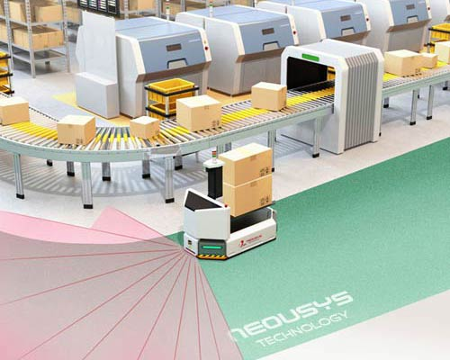
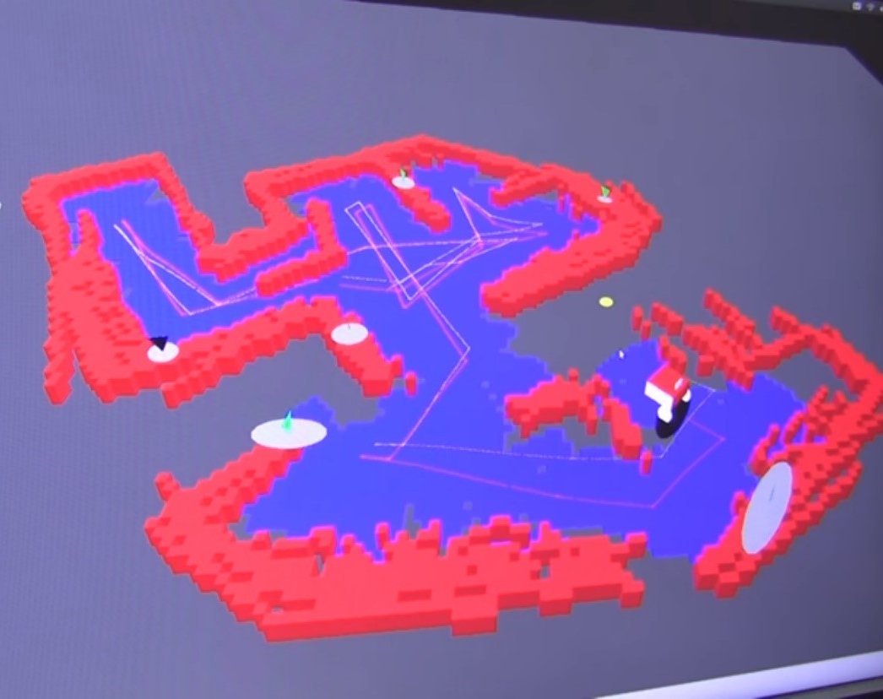
Vision Based Navigation

Slide 15
METHODOLOGY
The AGV includes multiple features and is designed to be seamlessly upgradable to incorporate future additions and enhancements as per specific industry requirement.
The AGV uses a landmark based navigation with a sensor-based feedback loop to combat obstacle detection.
The AGV features 2 operational modes.
The unit is battery powered and the typical use case will be to replace forklifts currently being used in industries and manufacturing stations.
The AGV is generally used to perform highly repetitive actions across defined paths and can work in tight spaces, owing to its excellent maneuverability.

Slide 16
METHODOLOGY
The AGV includes multiple features and is designed to be seamlessly upgradable to incorporate future additions and enhancements as per specific industry requirement.
The AGV uses a landmark based navigation with a sensor-based feedback loop to combat obstacle detection.
The AGV features 2 operational modes.
The unit is battery powered and the typical use case will be to replace forklifts currently being used in industries and manufacturing stations.
The AGV is generally used to perform highly repetitive actions across defined paths and can work in tight spaces, owing to its excellent maneuverability.

Slide 17
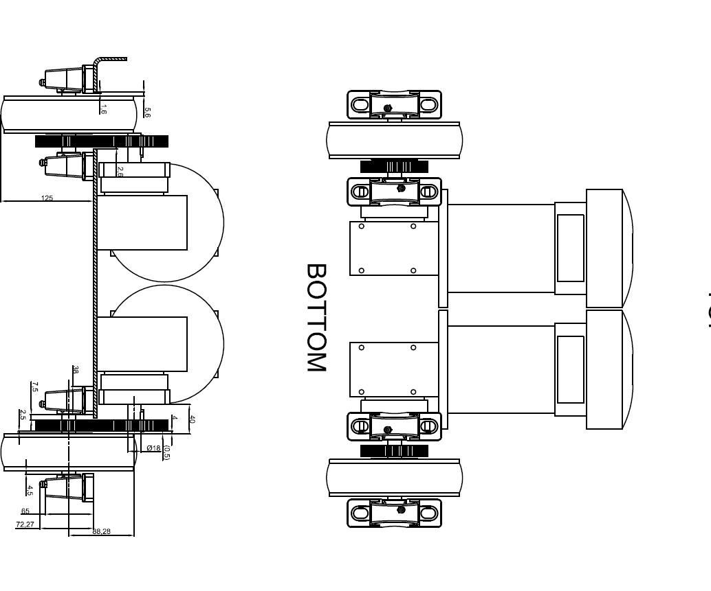
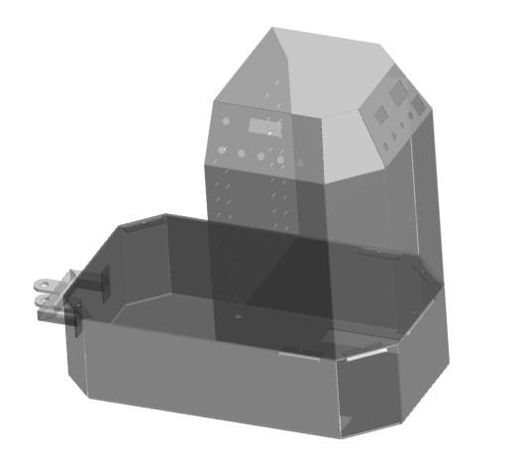
Design of the agv
The AGV design includes various convenience features such as
Axially-inverted location calling switches on either side of the AGV.
A master emergency stop button to directly cutoff power to the motor.
A 3 Position switch to easily change the mode of operation.
Differential Lighting to indicate operation, obstacles, charging.
Night mode lights, including back lit buttons and switches.

Slide 18
Design of the agv
The AGV design includes various convenience features such as
Axially-inverted location calling switches on either side of the AGV.
A master emergency stop button to directly cutoff power to the motor.
A 3 Position switch to easily change the mode of operation.
Differential Lighting to indicate operation, obstacles, charging.
Night mode lights, including back lit buttons and switches.

Slide 19
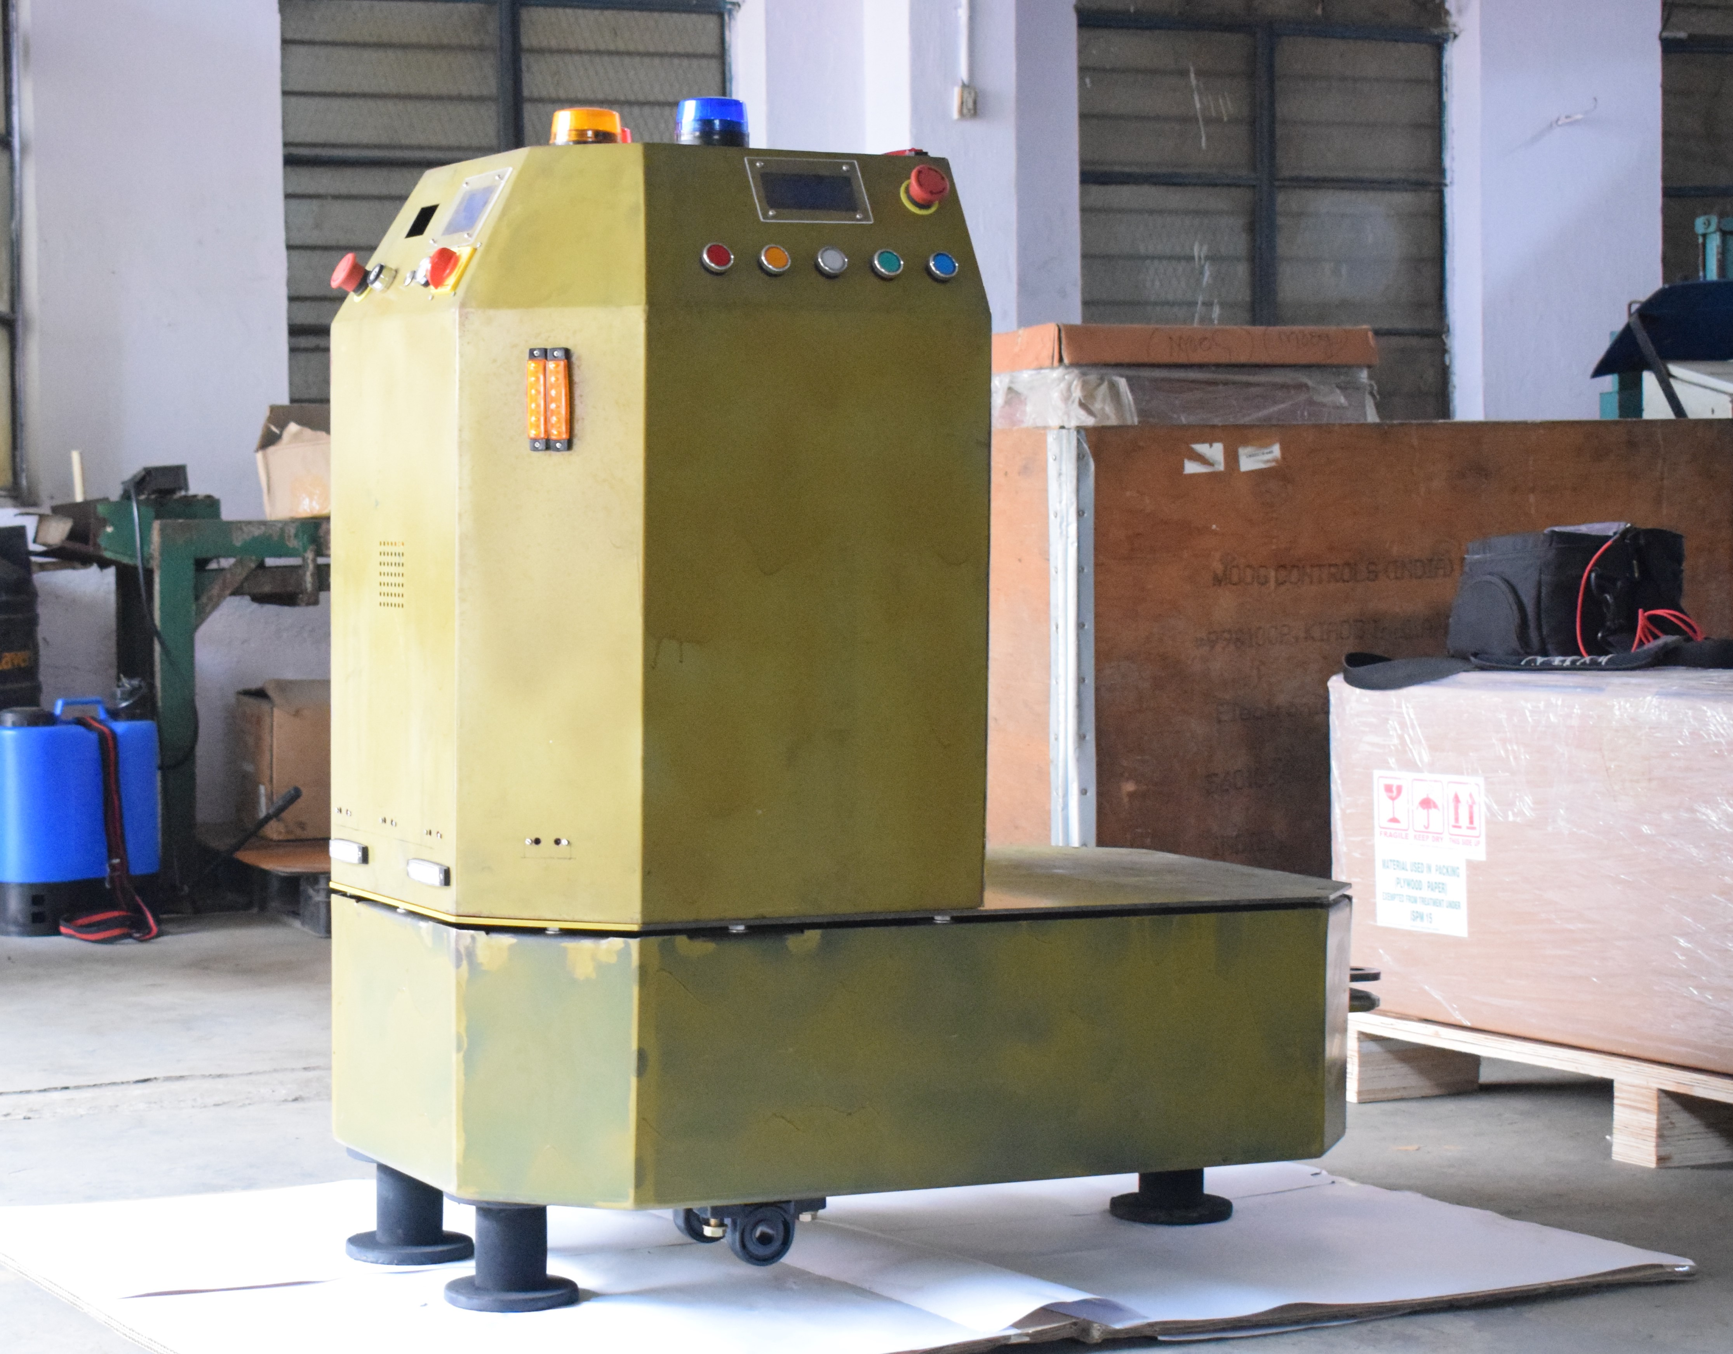
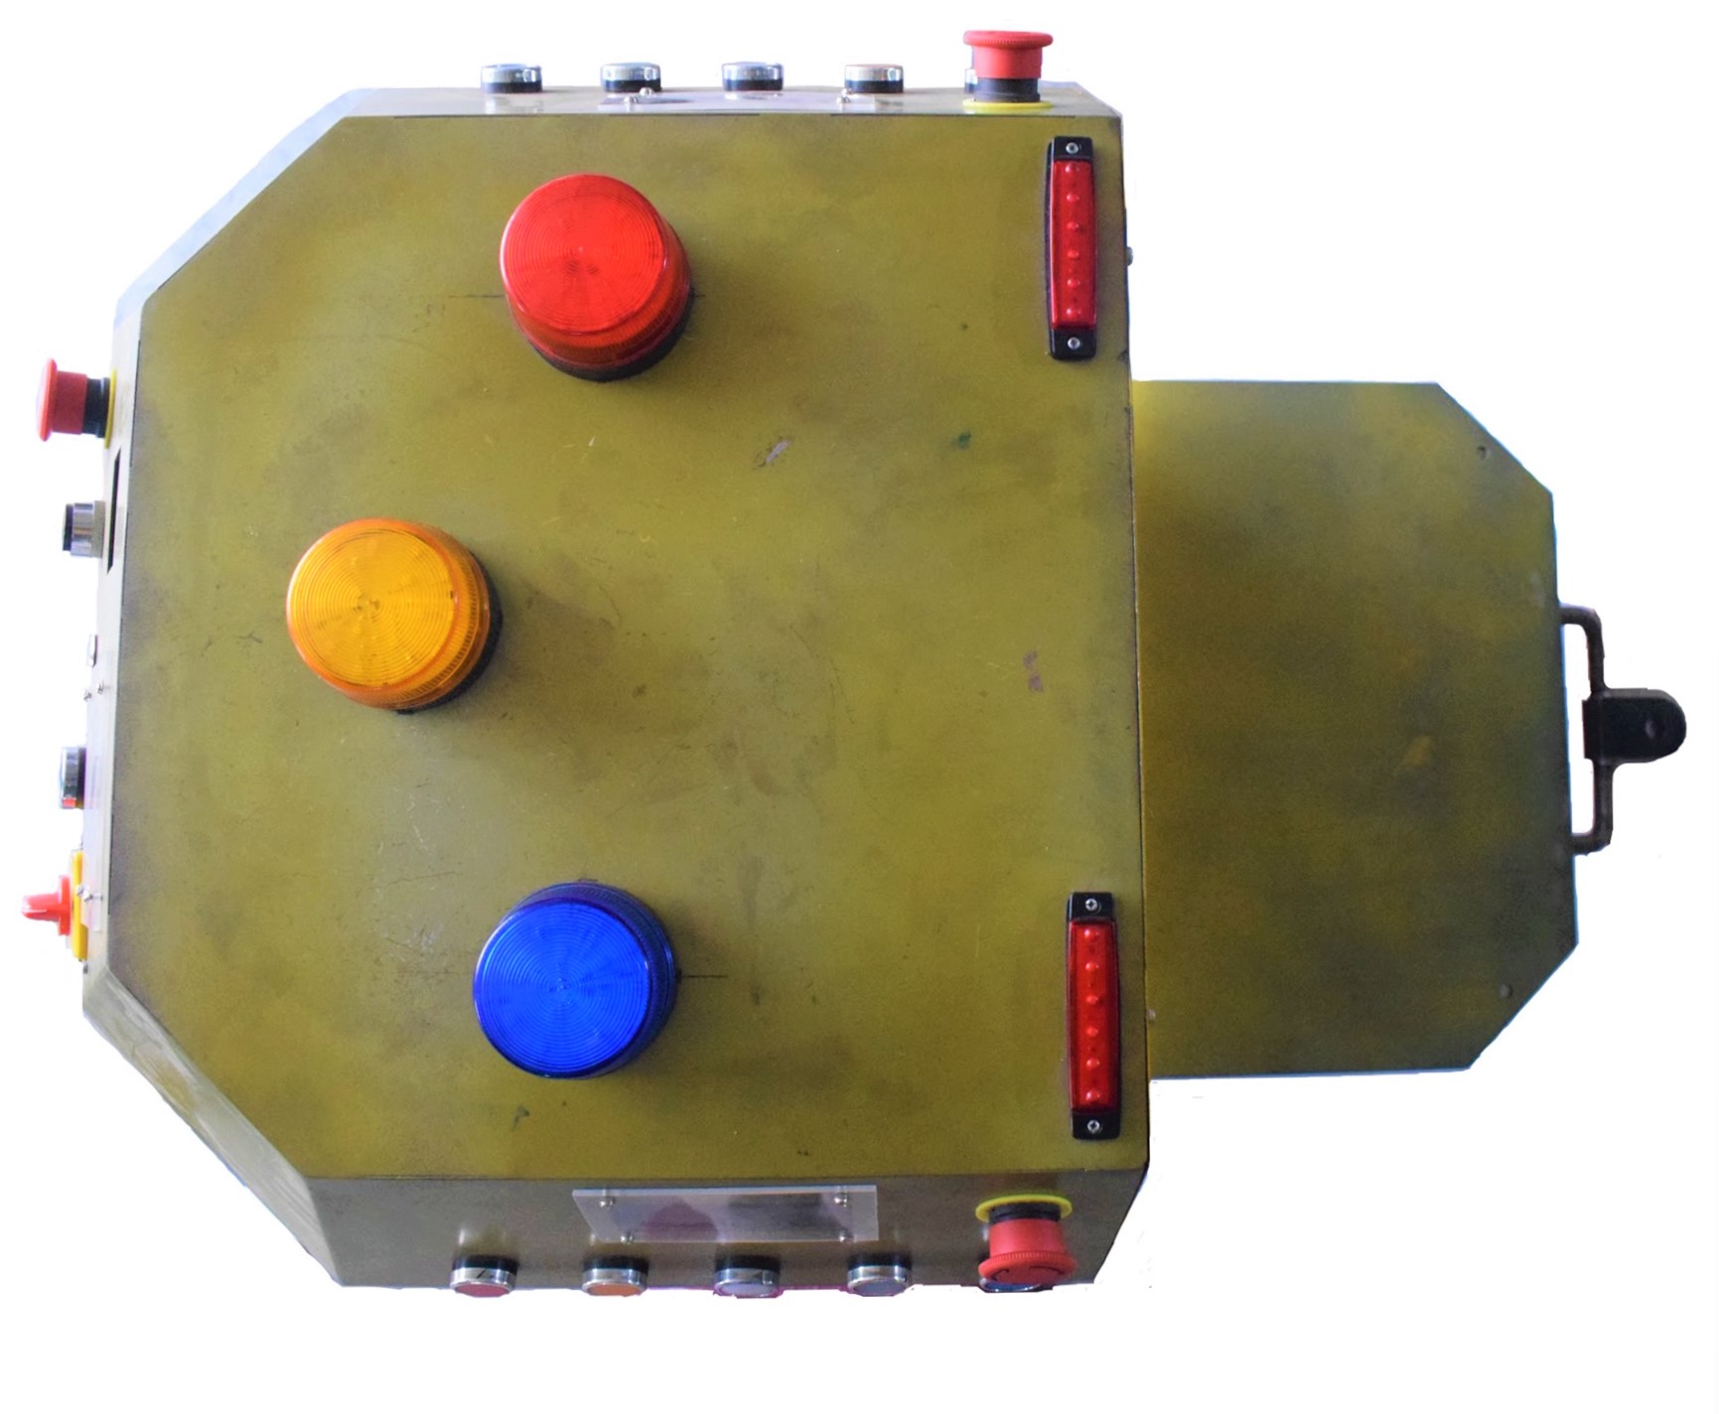
Design of the agv
The AGV also includes various features such as:
Electrical network consisting sensor nodes, voltage and current surge protection.
Backlit LCD display to provide mode and status information.
3-phase obstacle detection to ensure safety.
360° maneuverability with manual control feature.
Unique suspension mounted sensor platform.

Slide 20
Hardware Components used
3 – Position Switch
Joystick Control
Cytron MDDS30 Motor Driver
Momentary Push Buttons
Nrf24l01 module
RFID
Cytron LSA08 Advanced Line Follower
LCD
Obstacle Detection
Temperature Sensor
SD Card Module
Operational Lights
Buzzer

Slide 21
Combinations: | 1 | 2 | 3 | 4 | 5 | 6 | 7 | 8 | 9 | 10 | 11 | 12 | 13
3 – Pos Switch
Joystick
Motor Driver
Push Buttons
NRF
RFID
Line Follower
LCD
Temp Sensor
Obstacle det.
Op. Lights
Buzzer
SD - Card

Slide 22
Ideas Explored
In terms of the NRF communication being used, it was felt to be lacking in certain aspects of its simplex nature.
Taking the example of when the AGV is being called remotely to a location ‘X’, the remote-call button transmits a message via NRF communication assuming that the AGV is free to receive the message, in case the AGV has already been called to another location ‘Y’ and is travelling to that location then it will be unable to receive the new location. Meanwhile the user is oblivious that the request has not been received.
To overcome this an acknowledgement-based system facilitated by means of half-duplex mode of communication was designed. The NRF module was programmed to communicate in both directions.

Slide 23
Experimental Features
Although the initial design and ideation of the AGV was completed, we conceptualized multiple new features/functionalities on the go.
These features were added to compensate for missing design elements.
During testing we found these features to greatly improve the quality of life.

Slide 24
Experimental Features
The following features were added:
Emergency Button: Provided to immediately bring the AGV to a halt whilst being controlled by a joystick in case of potential hazards occurring during operation.
Load / Unload Button: Provided to prevent the AGV from accepting remote calls(and hence moving) upon reaching a destination while unloading of the AGV is in progress. This is a button that while toggled prevents the AGV from performing any operation.
Remote Call Buttons: It was noticed that when the AGV had to be called to a location which is at a considerable distance from it, one had to walk all the way to the AGV to access the location call buttons on it. To overcome this drawback, remote location call buttons were added at each location. This facilitates the ability to summon the AGV remotely

Slide 25
RESULTS AND DISCUSSION
The AGV was successfully designed and programed. The project followed a modular approach where each individual component was integrated into the robot with separate as well as combines iterations to test its compatibility and synchronization with other components.
Numerous design features were introduced during the pre-testing phase.
41 iterations of the master code were worked on in order to improve time and space complexity of the program. Each iteration greatly improved the efficiency of the code.
The AGV is currently undergoing testing under factory conditions to ensure perfect operation of it’s time critical operations.

Slide 26
CONCLUSION
AGV’s can be adopted in any environment as they are cheap among the autonomous robots. There is a significant amount of difference between theoretical and practical work cycle ,which can be optimized by adopting different methodologies.
In addition, one could think of utilizing advanced operation systems like ROS which would directly result in the performance of the AGV system being improved.

Slide 27
FUTURE WORK
Over the past several years, the capabilities of AGV systems have skyrocketed as software and sensor technology has improved. Companies now provide vehicles with more accuracy, safety, and efficiency than ever before, and the next few years hold possibly even more promise than the previous ones. Several technologies, could make an immense impact on the AGV industry such as:
LiDAR Sensors
Cloud Computing
Integrating software

Slide 29
REFERENCES
[1] Deepak Punetha, Neeraj Kumar, Vartika Mehta Development and Applications of LineFollowing Robot Based Health CareManagement System , IJARCET volume 2 issue 8 2013
[2] Feng, L., Koren, Y., and Borenstien, J., "A Cross-Coupling Motion Controller for Mobile Robots," IEEE Journal of Control Systems, December, 35-43 (1993).
[3] Bajestani, S.E.M., Vosoughinia, A., “Technical Report of Building a Line Follower Robot” International Conference on Electronics and Information Engineering (ICEIE 2010), vol 1,pp v1-1 v1-5,2010.
[4] Malhotra Rajiv, Sarkar Atri; ―Development of a Fuzzy Logic Based Mobile Robot for Dynamic Obstacle Avoidance and Goal Acquisition in an Unstructured Environment‖; Proceedings of IEEE/ASME, International Conference on Advanced Intelligent Mechatronics, pp.235-247, 2003
[5] Colak, I., Yildirim, D.,"Evolving a Line Following Robot to use in shopping centers for entertainment",Industrial Electronics, 2009. IECON '09. 35th Annual Conference of IEEE,pp.3803 - 3807,3-5 Nov. 2009.

Slide 30
Thank You

